Slide 1

HEXBUGS 2.0:
Obstacle Avoiding Robot

Slide 2

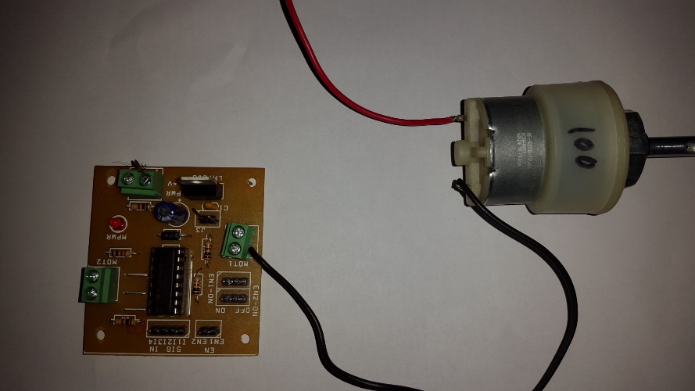
Connections: Motors -> L293D
The Motors have a RED wire and a BLACK wire.
Each of these wires is to be connected to MOT1 and MOT2 ports on the L293D.
The BLACK wire is to be connected to the side the port labels are printed on as illustrated below.

Slide 3
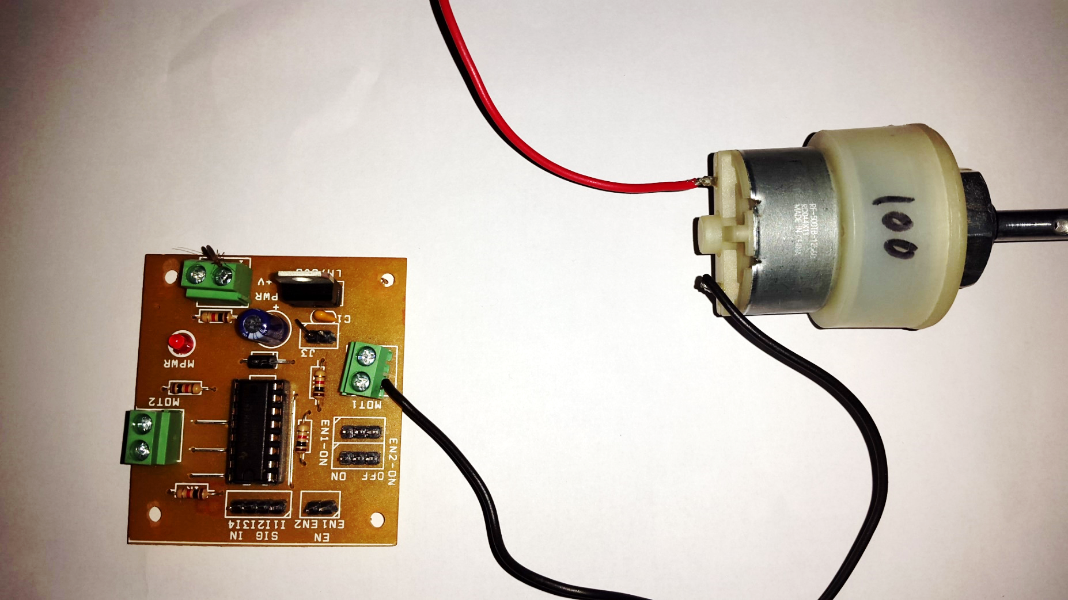

Slide 4
Connections: NODE MCU -> L293D
The following connections have to be made between the two boards :
I1 -> PIN D0
I2 -> PIN D1
I3 -> PIN D2
I4 -> PIN D3
Note : The pins mentioned are the Digital Pins and not the Analog ones.

Slide 5
Ultra Sonic Sensor:
As the name indicates, ultrasonic sensors measure distance by using ultrasonic waves. The trigger eye emits an ultrasonic wave and receives the wave reflected back from the target.
Ultrasonic Sensors measure the distance to the target by measuring the time between the emission and reception.

Slide 6
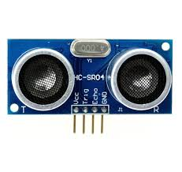

Slide 7
Connections: NODE MCU ->
Ultrasonic sensor
The following connections are to be made between the two boards :
ULTRASONIC- > NODE MCU
Trigger | D7
Vcc | 5V
GND Echo | Gnd D8

